Slide 1
Financial Performance Analysis -
The analysis reveals this organization is highly profitable with exceptional revenue growth, but with concerning patterns in expense management, regional performance and opportunities for operational optimization. The company has achieved remarkable 87% revenue growth over 24 months, maintaining an impressive 80.5% average profit margin. However, a 60.9% expense overrun ($63.48M above budget) represents a significant concern requiring immediate management attention.
87% REVENUE GROWTH · 24 MONTHS

Slide 2
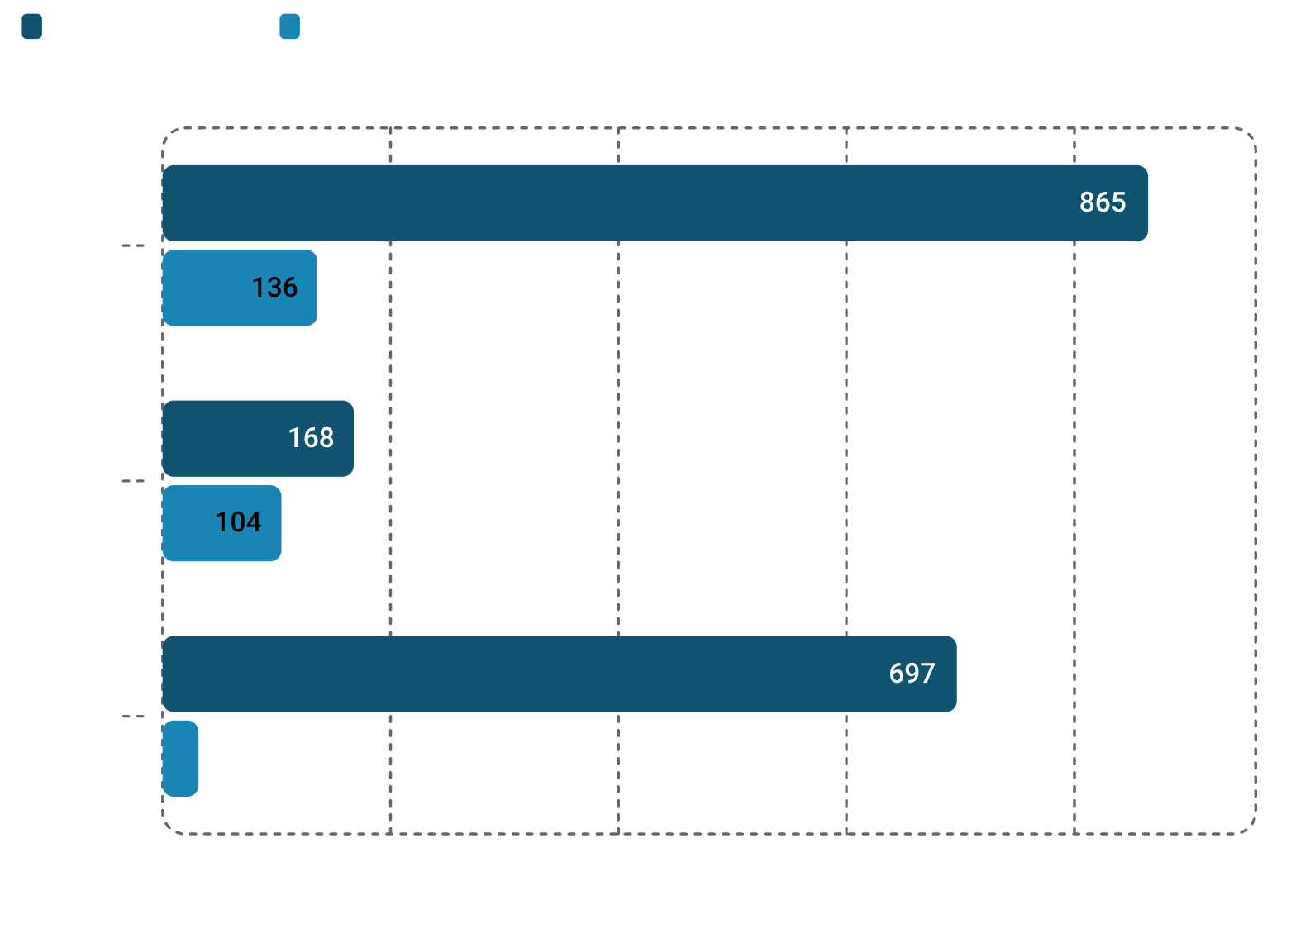
High-Growth, Highly Profitable Organization
Revenue
Net Profit
$864.61M vs. Budget $135.81M — 536% above target
$696.87M — 80.5% margin
Expense Overrun
Revenue Growth
+$63.48M — 60.9% above budget
87% over 24 months
Key Insight: Expense growth (32%) is well below revenue growth (87%) – strong operating leverage, but budgeting needs recalibration.

Slide 3
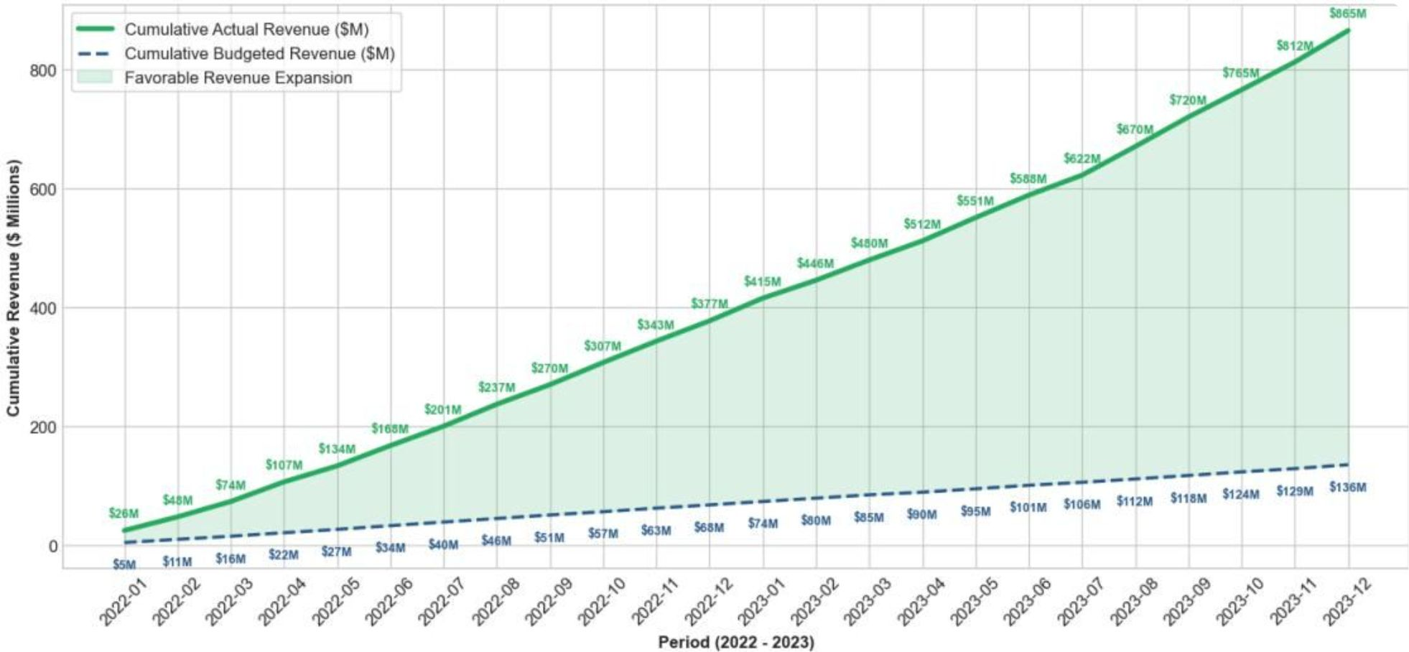
Revenue Growth: Consistent & Accelerating
Steady Climb
Revenue rose from $28.25M (Jan 2022) to $52.88M (Dec 2023) — no seasonal dips, purely structural growth.
Budget-Crushing Performance
Actual revenue exceeded budget by 536% overall, with a cumulative $728.79M advantage above the baseline.
Next Move
Leverage Enterprise segment's 4.15x ROI to accelerate further growth initiatives across all periods.

Slide 4
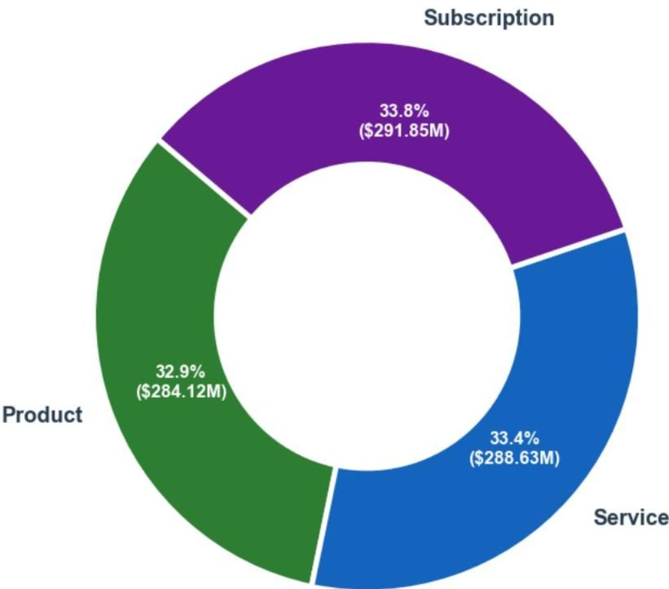
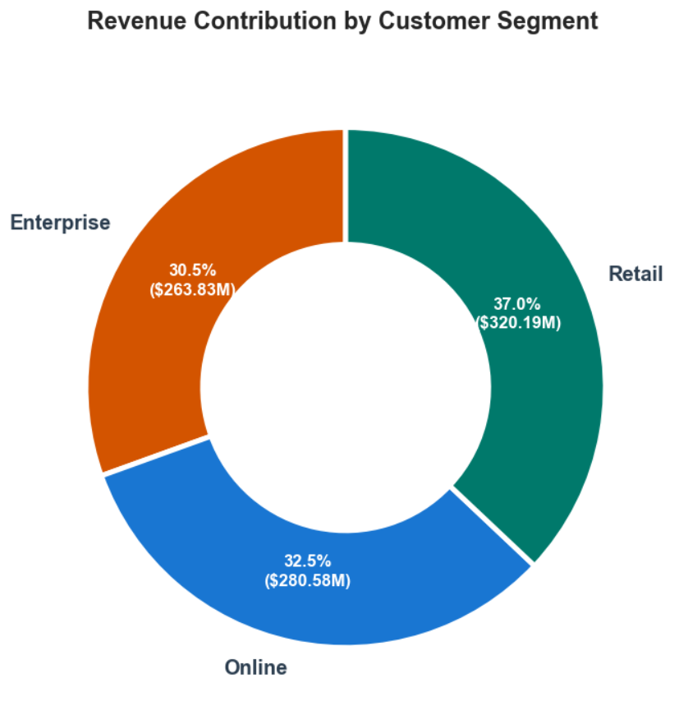
Revenue is Remarkably Balanced Across Categories & Units
Category Split — Nearly Equal Distribution
Business Unit Split — All Profitable
Subscription
Service
33.8% · $291.85M
33.4% · $288.63M
Recommendation: Focus growth on Enterprise (highest ROI at 4.15x) and Service category for margin expansion.
Business Implications: The company has achieved remarkable revenue growth with excellent diversification. The balanced distribution across categories and segments reduces risk and indicates effective market positioning.
Product
32.9% · $284.12M
Max difference: only $7.7M between categories.
Online
Retail
Enterprise
$297.53M · 79% margin
$285.68M · 81% margin
$281.40M · 80% margin

Slide 5
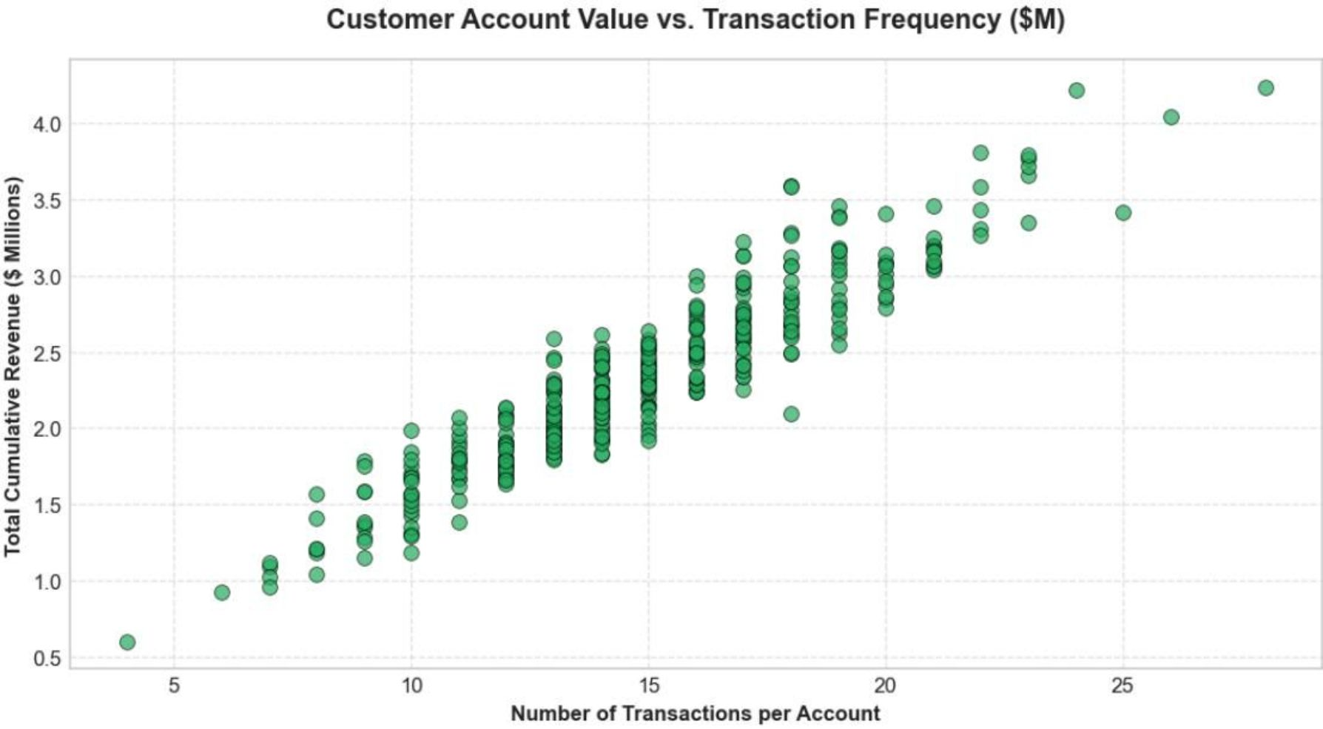
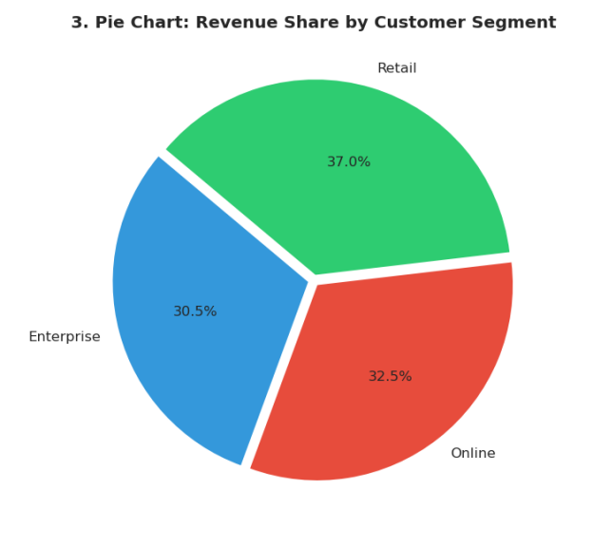
Customer Base is Well-Diversified & Low-Risk
Segment Distribution
37%
32.5%
30.5%
Retail
Online
Enterprise
$320.19M
$280.58M
$263.83M
All segments within 0.7% of each other – exceptional balance.
Low customer concentration reduces revenue risk. However, vendor concentration suggests dependency risk and cost optimization opportunities.
Top 10 customers = only ~4.5% of total revenue – low concentration risk. Strengthen mid-tier customers via cross-selling to boost average transaction value.

Slide 6
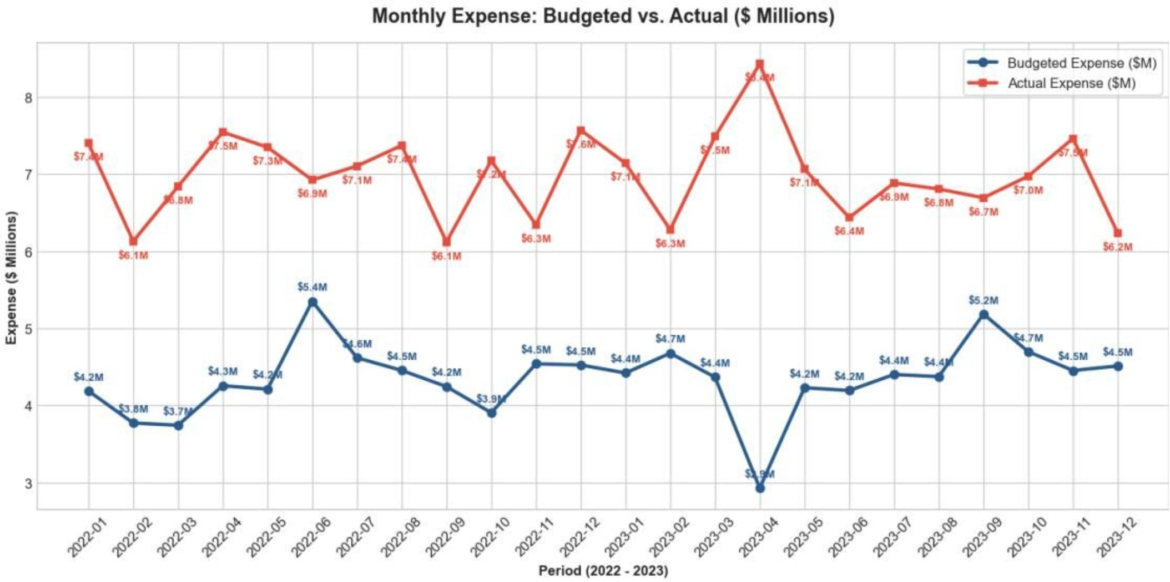
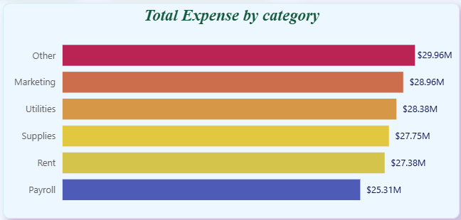

Expense Growth is Controlled, but Budget Overruns Demand Action
Overall Performance
Top Expense Categories
Actual Expense
Overrun
Rent + Payroll = 81.6% of total expenses – limited flexibility. Launch zero-based budgeting review and renegotiate vendor contracts.
The lower expense growth rate compared to revenue indicates effective scaling. However, the 60.9% budget overrun suggests budgeting processes need revision. The concentration of expenses in Rent and Payroll (81.6%) limits flexibility.
$167.74M vs. Budget $104.27M
+$63.48M — 60.9% above budget
Expense Growth
32% vs. Revenue Growth: 87%
Rent — 48.8%
$81.8M
Payroll — 32.8%
$55.1M
Supplies — 11.6%
$19.5M
Utilities — 6.8%
$11.4M

Slide 7
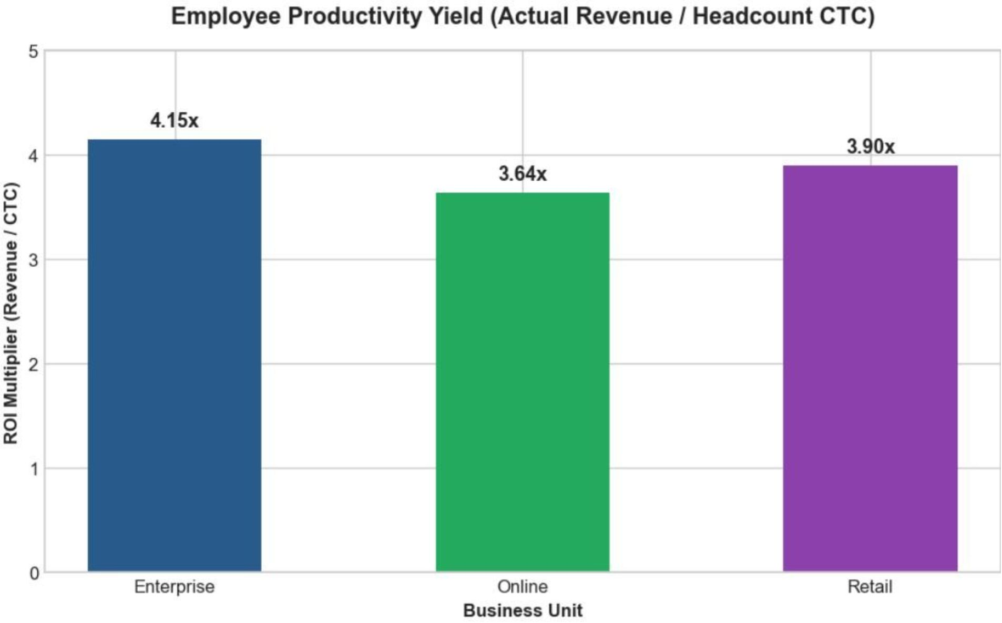
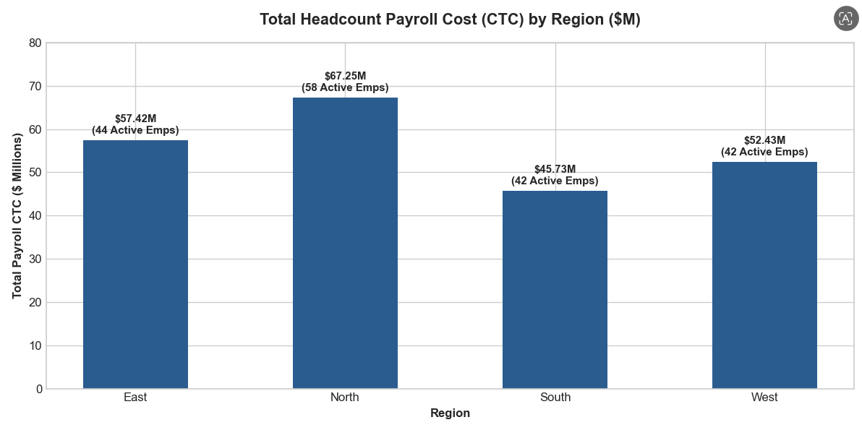
Employee Productivity Varies Significantly – Opportunity for Knowledge Transfer
4.15x
3.90x
3.64x
Enterprise
Retail
Online
Highest efficiency — 57 active employees
61 active employees | Avg CTC: $1.11M
68 active employees | 20% gap vs. Enterprise
Recommendation: Replicate Enterprise's best practices across Online and Retail; consider rebalancing headcount to higher-ROI units.

Slide 8
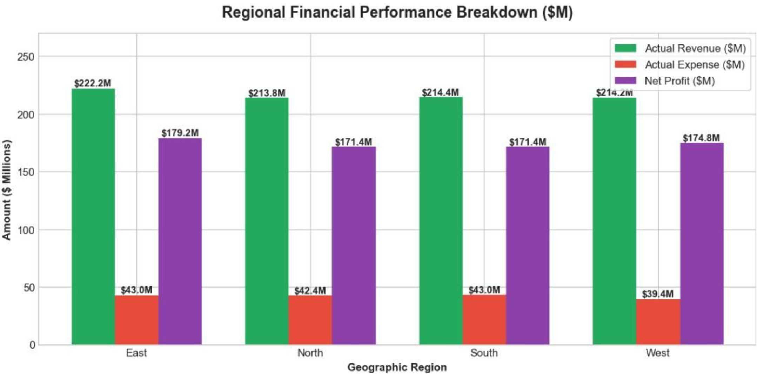
Regions wise Profitable -
Revenue by Region
Expense Efficiency & Profitability
Region
Revenue
Headcount
West has the best expense-to-revenue ratio (19.1%) but the lowest revenue
All regions maintain >80% profit margins
The consistent high profitability across all units indicates effective business model replication. The 102% profit growth demonstrates strong operational leverage and market execution.
East
$221.44M
50
North
$221.28M
60
South
$215.47M
43
West
$206.42M
47
Recommendation: Invest in West region's sales capacity while maintaining its cost efficiency — use it as a benchmark for other regions.

Slide 9
Vendor Costs are Concentrated – Opportunity for Savings
Top Vendors by Expense
Vendor Portfolio Metrics
Vendor
Category
Expense
Total Vendors
Mean Expense
Crawford, Solis & Jackson
Supplies
$2.83M
120 active suppliers
$1.40M per vendor
Walker Inc
Supplies
$2.77M
Median Expense
Dorsey, Barrera & Parker
Utilities
$2.73M
$1.54M per vendor
Boyd, Lozano & Gomez
Utilities
$2.68M
Recommendation: Consolidate procurement with top vendors; renegotiate volume discounts; explore alternative suppliers for Utilities to reduce dependency risk.
Top 5 vendors each exceed $2.4M — high concentration creates dependency risk.

Slide 10






Strategic Recommendations – Four Pillars
Revenue Optimization — High Priority
Expense Management — Critical Priority
Expand Enterprise Segment → 15–25% growth potential
Grow Service Category → 10–15% increase
Develop West Region → 5–10% growth
Vendor Consolidation & Negotiation → 10–15% savings
Budget Review & Refinement → 20–30% variance reduction
Regional Cost Standardization → 5–10% cost cut
Operational Optimization — Medium Priority
Data Governance — Foundation
Transfer Productivity Best Practices → 10–15% efficiency gain
Rent & Payroll Optimization → 5–10% each
Fix Missing Customer/Vendor IDs → Improved analytics
Establish Data Quality Framework → Sustainable insights

Slide 11
Summary & Next Steps
Strengths
Implementation Timeline
87% revenue growth with 80.5% profit margin
Balanced revenue across categories, segments, and regions
Low customer concentration – diversified revenue base
Strong operating leverage – expense growth (32%) < revenue growth (87%)
Build on excellence – act on expense management to unlock even higher profitability.
First, we need to monitor the ROI of our sales and marketing spend. We've proven it works, but we must ensure efficiency scales.
Second, we must resolve the data issue with Data—it's a red flag for data integrity. Third, we need to optimize costs in the Retail unit, which is our highest-cost performer.
Finally, our budget is clearly misaligned—we need to recalibrate to reflect our new reality.
Critical Areas to Address
$63.48M expense overrun (60.9% above budget)
Vendor concentration & dependency risk
Employee productivity gap (3.64x–4.15x across units)
Data quality gaps (missing customer/vendor IDs)
Q1 2024
1
Budget review, expense controls, vendor negotiation
2
Q2 2024
Enterprise growth initiatives, regional strategy rollout
Q3–Q4 2024
3
Productivity transfer, data governance rollout

